Slide 1
FAKE NEWS DETECTION

Slide 2



Slide 3


Slide 4
PROBLEM STATEMENT
Fake News have become more prevalent in recent years and with great amount of dynamism in internet and social media, differentiating between facts and opinions, relating to commercial or political has become more difficult.
The internet is used intentionally or accidentally to spread false information. People and culture have been forever changed by the massive spread of fake news.
We decided to use various NLP and preprocessing methodologies like tokenization, stop words removal, lemmatization, stemming and machine learning classification algorithms - logistic regression, PAC, ADA, Naive Bayes, SVM, Random Forest, XG-boost, decision trees and RNN, to build a model that differentiates between fake news and real news and also analyze the performance of these various classification methodologies to choose the best classifier.

Slide 5
TYPES OF DATA IN SOCIAL MEDIA POSTS
1. Text: Computational linguistics analyzes text, focusing on the genesis of text semantically and methodically. Because many of the posts are written in the form of texts, much work has been carried out into analyzing them.
2. Multimedia: Several types of media are combined in a single post. Audio, video, photos, and graphics may all be included. This is highly appealing, because it captures the attention of the visitors without requiring them to read the content
3. Hyperlinks: Hyperlinks allow the post's creator to cross-reference to other sources, gaining viewers' trust by confirming the post's genesis. Cross-reference to other social media networking sites, as well as the embedding of photos, is common practice.

Slide 6
TYPES OF FAKE NEWS AND PATTERN THAT HELP IN DETECTION
1. Visual Based: These false news posts make extensive use of graphics as compared to content, which may include manipulated photographs, doctored video, or a combination of the two.
2. User Generated News: This sort of falsified news is generated by phoney accounts and is targeted to certain audiences, which might reflect specific age groups, gender, culture, or political affiliations.
3. Knowledge based: These posts provide scientific (so- called) explanations to some unresolved problems, leading people to feel they are genuine. For example, natural therapies for high blood sugar levels in the human body.
4. Style based: Pseudo Journalists who impersonate and mimic the style of some accredited journalists write style-based posts.
5. Stance based: It is a portrayal of true statements in such a way that its meaning and purpose are altered.

Slide 7
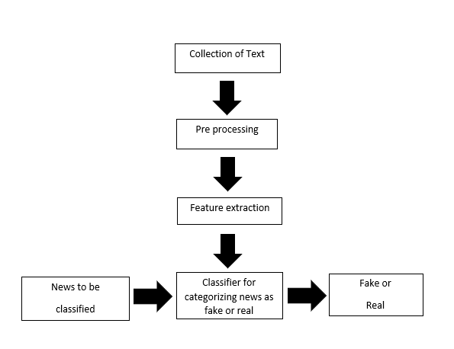
METHODOLOGY
The fake news model detection is built using following steps : Text Collection, Text Preprocessing, Feature Extraction and then finally classification using different classifiers.

Slide 8
ALGORITHM TO BE USED LIBRARIES TO BE USED 1)Logistic Regression 1)Pandas 2)SVM 2)Numpy 3)Naïve Bayes 3)Matplotlib 4)XG Boost 4)Scikit-learn 5)Random Forest 5)Tensorflow 6) Passive Classifier 6)seaborn 7) ADA Aggressive Boost Classifier 8)Decision Tree

Slide 9
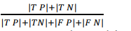
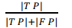
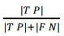
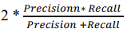
ANALYSIS
We can evaluate machine learning algorithm using various metrics like
Accuracy =
Precision =
Recall =
F1-Score =

Slide 10
